Slide 1
Workshop Agenda
January 2022 – Extension Activity
22 Jan 2022

Slide 2


Agenda
11-11:15: Loyce overview of workshop, the GenCyber program and other UMCG programs, events, degrees, certs for teachers
11:15-11:25: Shannon - Overview of the day, Agenda review, RPi review, lab kickoff
11:30-12:30: Kim - Intro to Linux Lab
12:30-1:00 - Break for lunch
1:00-2:00: Shannon - Wireshark lab
2:00-2:15 Break
2:15-3:15 Jonathan and password auditing
3:15-3:30 Wrap-up
Team - answer any outstanding questions
Loyce - discuss future sessions and requirements for program
Thank you's :-)

Slide 3
Workshop Overview
Using the Kali OS running on the Raspberry Pi (RPi)
Introduce the affordable hardware environment of the RPi
Practice using Kali Linux and Linux commands at a command line interface (CLI)
Explore a few of the many pre-installed cybersecurity-related programs on Kali Linux

Slide 4
Organization of the Workshop
Introduction / Practice with Kali
Network forensics with Wireshark
Password auditing using John the Ripper

Slide 5
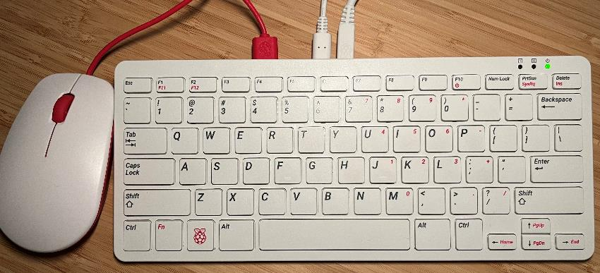
Raspberry Pi 400
Complete personal computer, built into a compact keyboard
Purpose-built board based on Raspberry Pi 4
Quad-core 64-bit processor
4GB of RAM
Wireless networking
Dual-display output and 4K video playback
40-pin GPIO header
This is what you were sent!
https://www.raspberrypi.com/products/raspberry-pi-400/

Slide 6
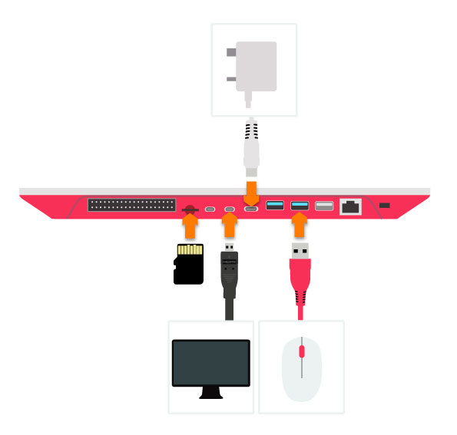
Overall Setup of Raspberry Pi 400
Image from: https://www.okdo.com/getting-started/get-started-with-raspberry-pi-400/

Slide 7
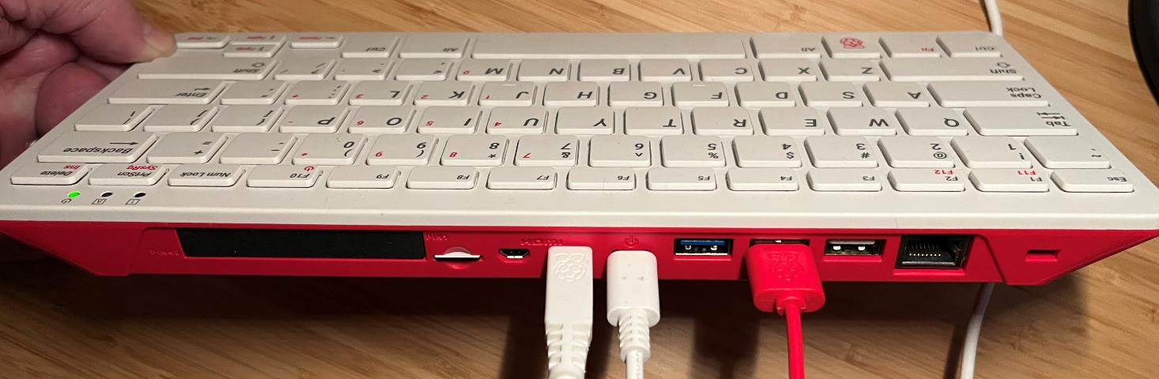
Rear of Raspberry Pi 400
All necessary connections made
Mouse (USB)
Monitor (microHDMI)
Power (USB C)

Slide 8
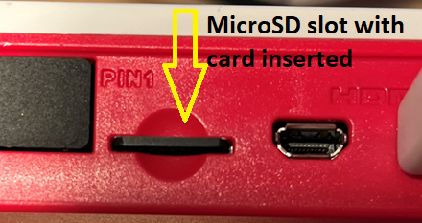
Before Powering Up - Swap the MicroSD Card
If you already have a microSD card inserted, replace it with the 32-bit Kali OS for RPi that was shipped to you.
Push in and when the card pops out, remove it and replace it.
Be sure the pins are facing toward the bottom of the keyboard *and* that you completely push and lock the microSD card into the slot

Slide 9
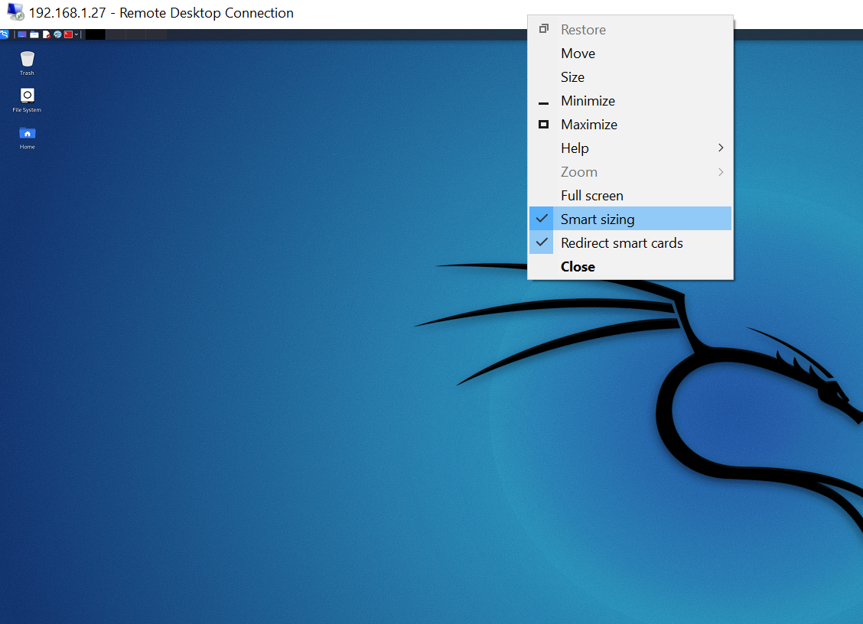
Booting the System
Turn on your monitor
Connect the power
Wait for system to boot
Text will roll by – expected!
Login to system
Username: kali
Password: kali
---------------------
Open a program
Such as Internet browser
Open a command line terminal
Run command such as “ls” to list directory contents

Slide 10
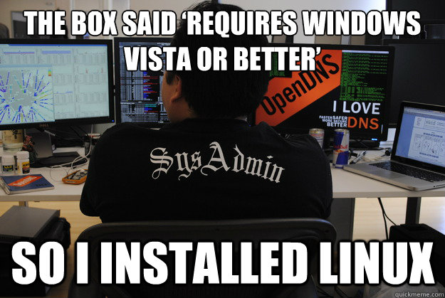
Intro to Linux Lab
Kim Mentzell
11:30-12:30

Slide 11

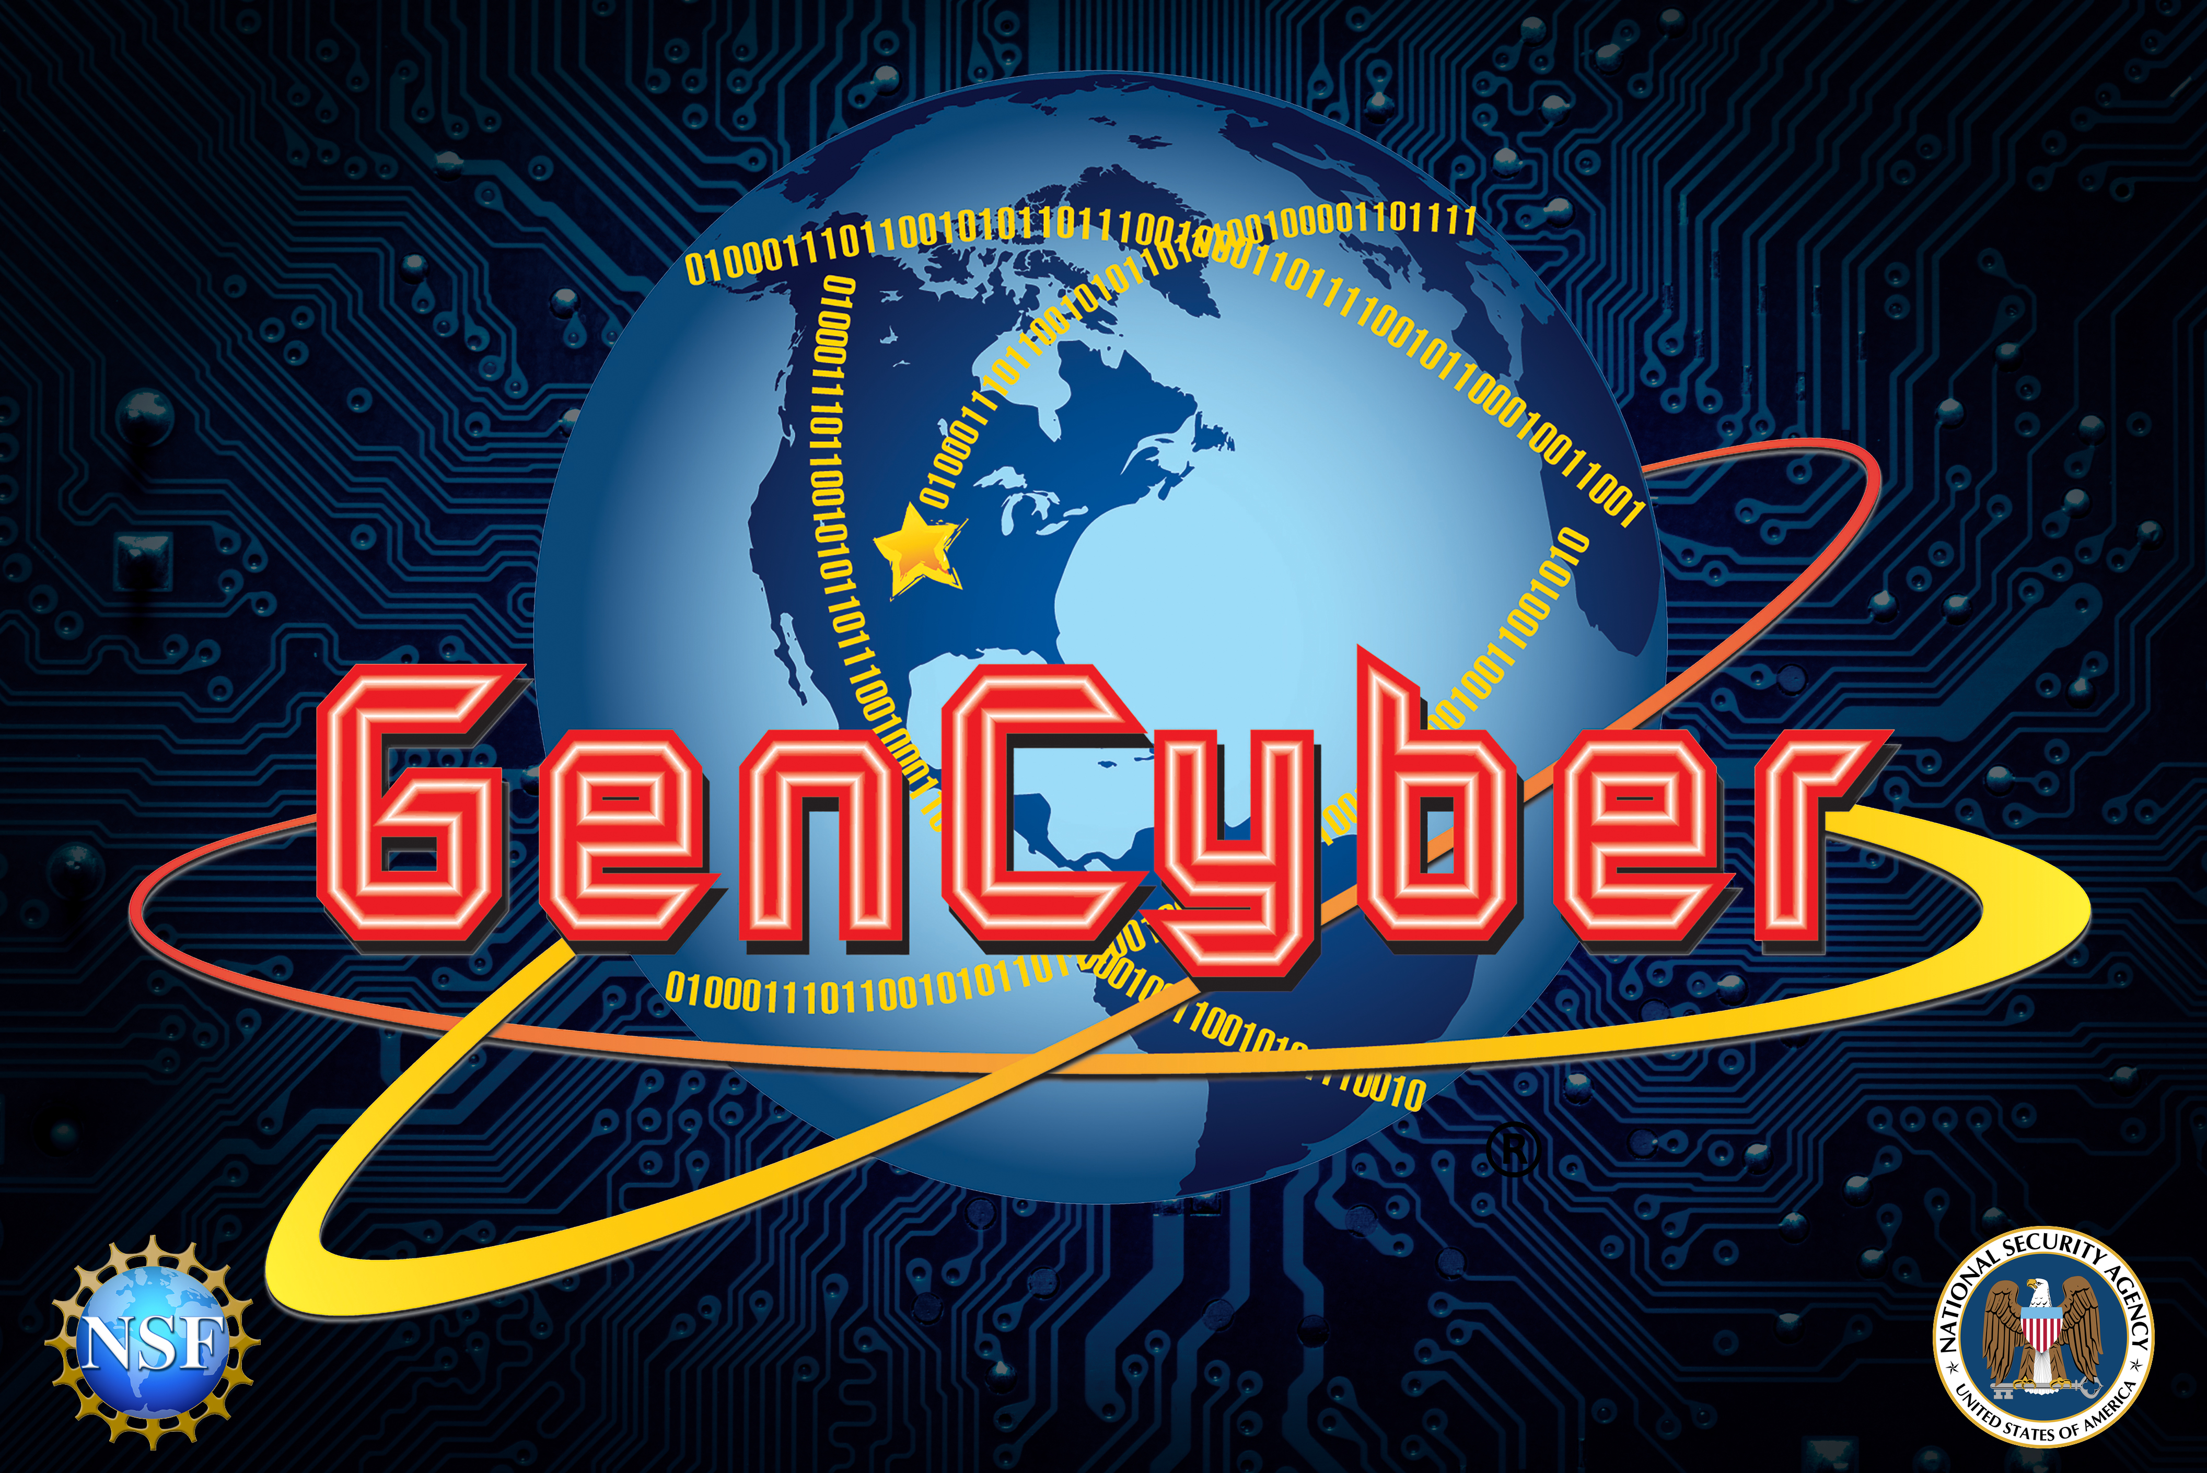
Introduction to Linux

Slide 12

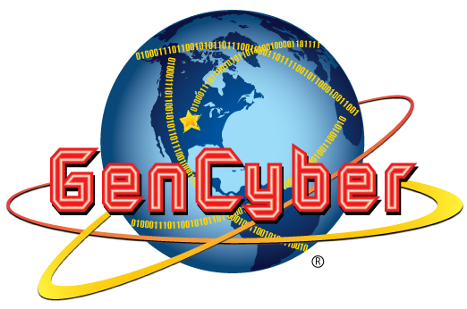
What we are going to cover
What is Linux?
How do we use Linux?
What are Linux Distributions?
Simple Linux commands
What can you do with Linux?

Slide 13

What is Linux?
Linux is an operating system written by volunteers called contributors
Linux allows you to use computer hardware to do things
The Linux ecosystem provides tools to run varied services such as web services or compute modules for advanced AI

Slide 14
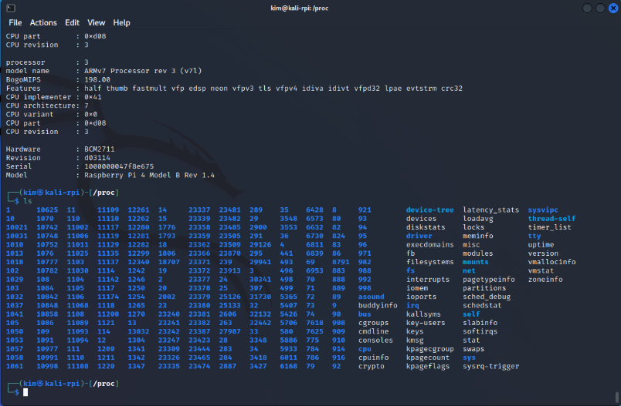
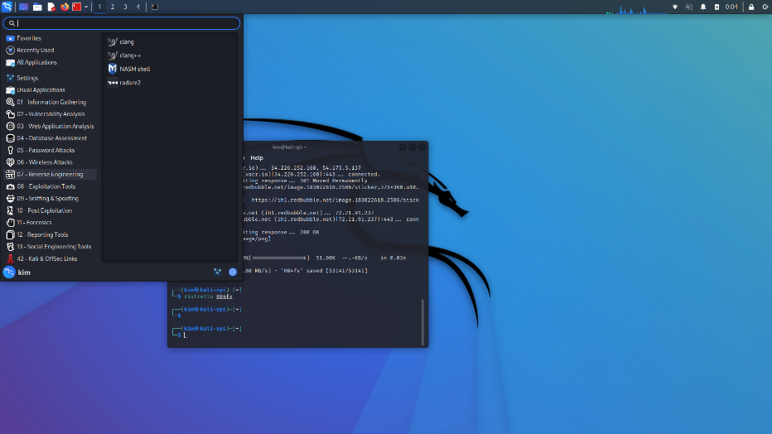
How do we use Linux?
Command Line
Graphical User Interface

Slide 15
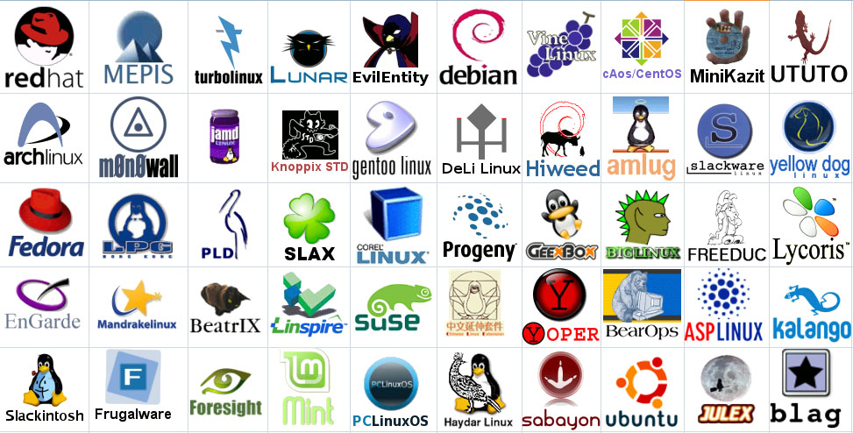
What is a Linux Distribution?
A Distribution is a series of packages bundled together by a group of maintainers.
The packages and the kernel (heart) make up a Distribution.
Some Distributions are maintained by companies (Debian, Ubuntu, Red Hat, Oracle, SuSE)

Slide 16
Simple Linux Command Reference
ls : Lists the files in a directory
cd : change directory
pwd : shows the present working directory
cat : concatenates a file – or displays it to the screen
less / more : pagination of output
tar : Tape ARchive. Old backup software, now used as a primitive way to package files.
cp / rm / mv : copy, remove and move a file
compress / gzip / bzip2 / xv : compression tools to make files smaller
touch : create a file or change its timestamp
useradd : create users
chown / chgrp : change owner and group permissions on a file
awk / sed / grep : modification of data in files or on the screen
echo : repeats a command to the screen
Pipes “|, <, >” : allow redirection of data between processes

Slide 17

What can you do with Linux?
Android Cell Phones
Super Computers
Microcomputers
Web Services
Data Processing
AI/ML
Cloud Servers
Databases
Game Consoles
Graphics Design
Video Authoring
Embedded Systems

Slide 18
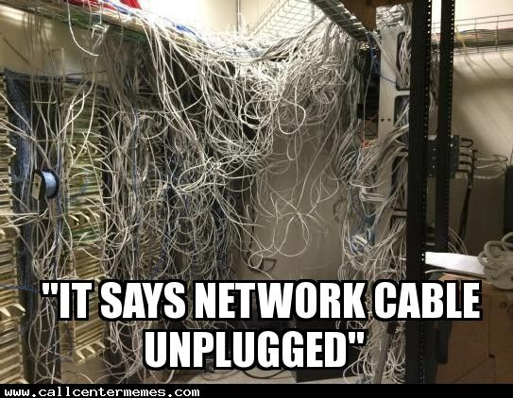
Wireshark Lab
Dr. Shannon Beck
1:00 – 2:00

Slide 19
Introduction to Networks and Wireshark
Overview of Networking

Slide 20




What is a Network?
When you connect two or more computers or devices, you have “networked” them together
Networks can use wires and radio waves (wi-fi)
Usually, you want or need more than two devices talking to each other
Introduce more networking hardware to help
A router symbol shows both wired and wireless network

Slide 21
Speaking the Same Language
Information exchange must be done so that all parties can understand the information being shared
What happens if you show up to a class and your teacher is speaking Korean and you only know French? How well does that information exchange work?
There has to be an agreement on the language used for exchanging human information
Computers are the same – they need to agree on how to exchange information
These network protocols provide a common “language” for how to communicate

Slide 22
Network Protocols
Definition: A set of rules that governs the connection of computer systems to the internet (Oxford Dictionary)
Ever heard of TCP/IP?
TCP = Transmission Control Protocol
IP = Internet Protocol
The two protocols are used together to establish and maintain a network conversation
TCP focuses on establishing and maintaining a network connection
Connection-oriented, knows if a packet is missing
IP defines how computers send packets of data to each other

Slide 23
Network Protocols – Continued
In addition to TCP, there is UDP
UDP = User Datagram Protocol
Unlike TCP, UDP doesn't guarantee that the packets will get to the right destinations.
UDP uses IP (Internet Protocol) as well
UDP is connection-less
UDP is less reliable than TCP
Relies on devices in between the sending and receiving computers to correctly get the data where it's supposed to go

Slide 24

Network Traffic
“Straw” - Network
Packets on a network are pieces of a file that sent over the network and re-assembled on the receiving side.
Imagine the network is a straw and you want to push through a sandwich.
How do you do it? One small piece (packet) at a time.

Slide 25


Network Data Packets Concept Map
internet
Original Image
Image divided up into packet-sized data pieces
IP sends packet to network
Network
Packets get sent to destination
Individual Packet

Slide 26
IP Addresses
Source Address
How does a packet know where it came from and where it’s going to?
Just like a letter, is uses addresses.
Source Address - the IP address of where it’s coming from (like a return address)
Destination Address – the IP address of where it’s going to
Destination Address

Slide 27
IP Addresses
Source Address
10.0.0.15
How does a packet know where it came from and where it’s going to?
Just like a letter, is uses addresses.
Source Address - the IP address of where it’s coming from (like a return address)
Destination Address – the IP address of where it’s going to
Destination Address
93.184.216.34

Slide 28
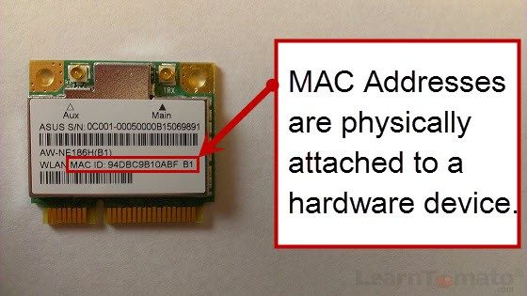
Other Identifiers – The MAC Address
Computers are assigned IP addresses through software (changeable)
The hardware has its own identifier, MAC address (non-changeable)
Assigned at manufacture time, the first three bytes map to manufacturer (OUI listing)
Can tell information about network hardware connected through the network traffic. The MAC address has (leaks) this information
MAC addresses can be spoofed (faked), but generally the way to identify a specific physical network device
Notes:
Image from https://learntomato.flashrouters.com/what-is-a-mac-address-how-to-find-my-mac-address/

Slide 29
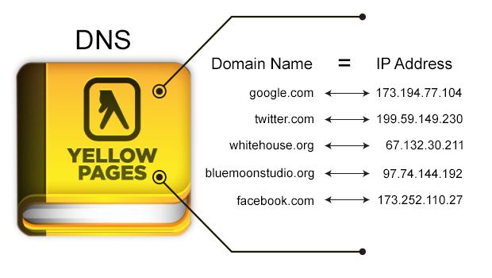
Not Lost in Translation
How do you get from “example.com” to the IP address 93.184.216.34?
Answer: the Domain Name System (DNS)!
DNS is like a phonebook for domain names mapped to IP addresses.
Notes:
Image from https://tibbbz.medium.com/pi-hole-dns-for-dummies-5763b65ee527

Slide 30
Ports
Port Number | Usage
23 | Telnet - Remote login service, unencrypted text messages
25 | Simple Mail Transfer Protocol (SMTP) E-mail Routing
53 | Domain Name System (DNS) service
80 | Hypertext Transfer Protocol (HTTP) used in World Wide Web
110 | Post Office Protocol (POP3) used by e-mail clients to retrieve e-mail from a server
123 | Network Time Protocol (NTP)
143 | Internet Message Access Protocol (IMAP) Management of Digital Mail
161 | Simple Network Management Protocol (SNMP)
194 | Internet Relay Chat (IRC)
443 | HTTP Secure (HTTPS) HTTP over TLS/SSL
Network ports indicate what type of service it is (email, file transfer, web).
Typical ports used when browsing the internet
Resolving a URL (www.example.com) to an IP address (198.41.0.4) uses the Domain Name System (DNS) on port 53
Unencrypted website traffic (HTTP) – Port 80
Encrypted website traffic (HTTPS) – Port 443
Notes:
Note about DNS. In the prior slide, the source and destination addresses are IP addresses.
Using TCP/IP, you can’t directly “go” to example.com. That first needs to use DNS to lookup the IP address, and then the request for the content at 198.41.0.4 is transmitted.

Slide 31

Do you think it’s possible to analyze data sent over the network?
Notes:
Yes! This is done for troubleshooting, performance measurements, and for security monitoring.

Slide 32
Wireshark
Wireshark is a powerful analysis software that allows you to not only capture network and device packets, but to analyze them too (i.e., a packet analyzer).
Remember - A packet is a fragment of data that is sent over a network from one machine to another. This data usually includes a source port, source IP address, destination port, destination IP, and other data that we will see in this lab.
Wireshark allows a user to analyze the traffic traveling in and out of the machine, which can serve many uses.
© 2020 Virginia Cyber Range. Created by Thomas Weeks. (CC BY-NC-SA 4.0)

Slide 33

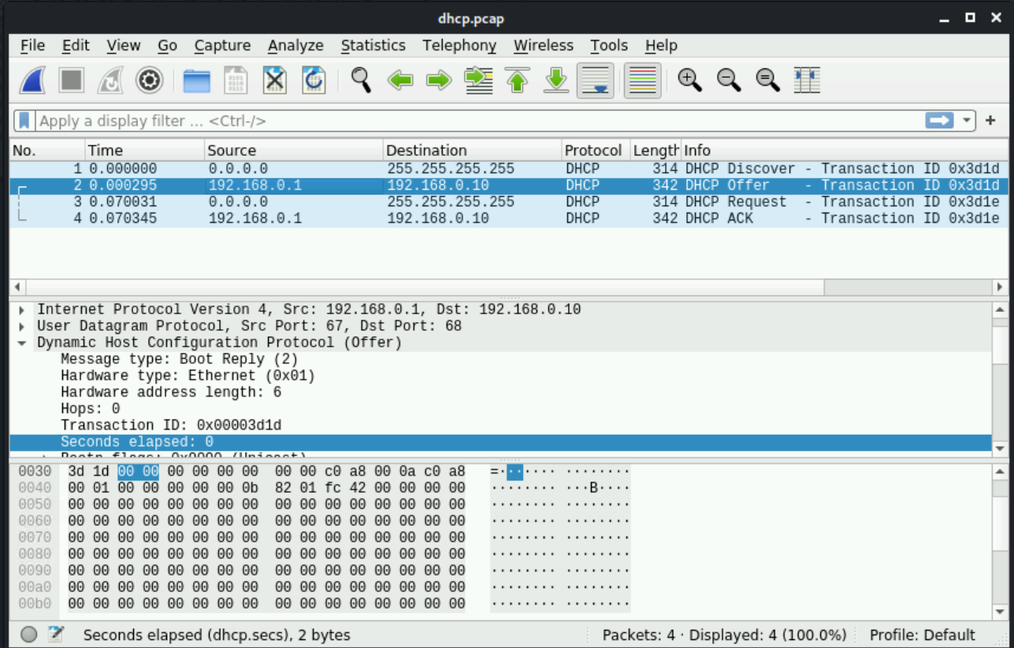
Wireshark
© 2020 Virginia Cyber Range. Created by Thomas Weeks. (CC BY-NC-SA 4.0)

Slide 34


Attack of the Sharks
≠

Slide 35
Why Use Wireshark?
Troubleshoot network connections.
Filter data between two hosts to see a single network “conversation.”
Comparing all “conversations” to discover bad actors or “bandwidth hogs.”
Filter captured data to analyze specific protocols and ports being used.
Analyze specific statistics about the traffic coming in and out of the system.
Adapted from © 2020 Virginia Cyber Range. Created by Thomas Weeks. (CC BY-NC-SA 4.0)

Slide 36
Wireshark Lab
Wireshark allows you to view pieces of data (called packets) in real-time as they go in and out of a system and can be saved as packet capture or pcap files.
In this lab, you will be analyzing packet capture files (network forensics).
The objectives at the end of the lab is understand:
Wireshark overview
Analyzing DNS Packets
Name-to-IP address resolution
Wireless access points and identifiers

Slide 37

Debrief

Slide 38
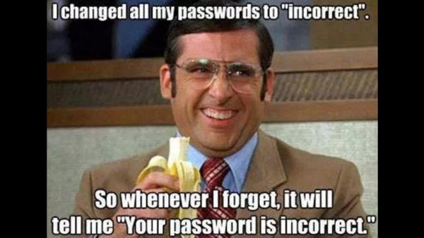
Password Auditing Lab
Jonathan Woodward
2:15-3:15

Slide 39
Password Auditing Lab

Slide 40
Authentication and Authorization
Authenticate – verify ID (you are who you say you are)
Something you know (password)*
Something you have (SMS phone, RSA key)
Something you are (biometrics like fingerprint)
Authorize – grant access to resources based on authentication
R-BAC – based on your role

Slide 41
Password Auditing Lab Objectives
Understand what makes weak and strong passwords
Demonstrate creating hashes from plain text passwords
Demonstrate how to use password cracking tools
Understand the difference between dictionary and brute force password cracking

Slide 42

Password Auditing*
Review and learn about password files in Linux
Using the John the Ripper
Free password auditing (cracking) tool
Find trivial passwords in a short amount of time
Accessible on multiple platforms
Can be run from within Metasploit or on its own
Takes the entry from salted password hash from /etc/shadow:
jsmith:$6$JRF8OgFTYSP1zDeO$2PuYhV7jFxrdY8x.4P73BspAXQZiv2S8Dr.hrFIGNXTWrIt6gdTiwnTr9cTgFurP4NPWT8isXwizoGRqt/iJ./:18659:0:99999:7:::
Reduces it to the password: 12345
*Hint: be careful where you use the word “hack”

Slide 43
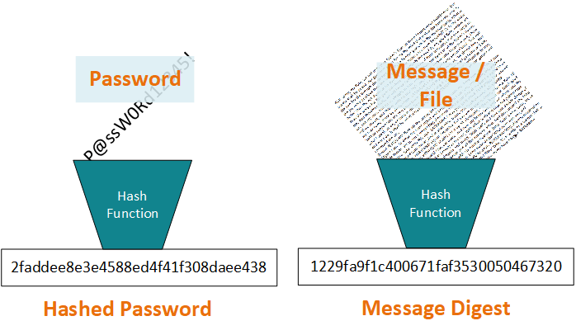
Background: What is a Hash?
A hash function maps digital data of arbitrary size to digital data of fixed size. The hash is sometimes called a message digest.
A cryptographic hash function is a hash function that is considered practically impossible to reverse (one-way-ness) or find collisions (i.e. two messages with the same hash value)
Same cryptographic hash function can be used.

Slide 44

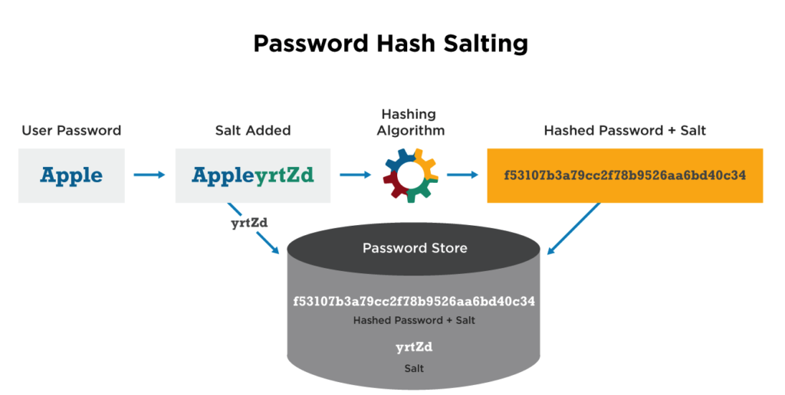
Password Hashing with Salt
Passwords aren’t stored in plaintext or plain hash, they are salted
Prevents Rainbow Table Attacks
🌈 Attack a hashed password in reverse with a table of pre-computed hashes with corresponding passwords 🌈
Adds a layer of security (Defense in Depth)
Image from https://cyberhoot.com/cybrary/password-salting/

Slide 45

Dictionaries in John
Not like the dictionary you think of
A list of words to try against the password hashes
Image source: https://images2.minutemediacdn.com/image/upload/c_fill,g_auto,h_1248,w_2220/f_auto,q_auto,w_1100/v1555926333/shape/mentalfloss/166091799.jpg

Slide 46
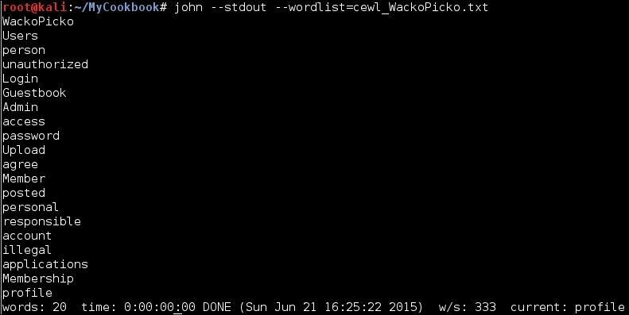
Custom Dictionaries in John
List 1:
cat
dog
panda
racoon
deer
List 2:
cat
dog
panda
racoon
deer
panther
puma
bear
chicken
corgy
welshcorgy
bordercollie
jump
run
audit
goat
horse
palamino
chestnut
…
Image source: https://static.packt-cdn.com/products/9781784392918/graphics/B04027_Ch02_23.jpg

Slide 47
Custom Dictionary
If know target (person) attacking, what are some good sources for knowledge and possible passwords?
Even the Linux built in “dictionary”

Slide 48
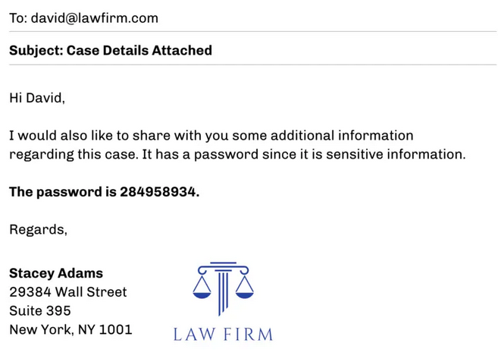
Defensive Uses of Password Cracking
Phishing Investigation
Notes:
Attackers will commonly hide malicious phishing attachments inside of password protected zip archives in order to evade antivirus scanning. In cases where the security responder does not have access to the original email, the only option to crack the password of the zip archive.

Slide 49
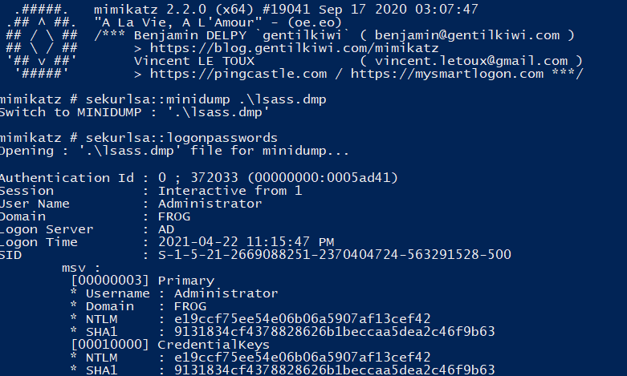
Defensive Uses of Password Cracking
Incident Response
Notes:
When investigating a breach, an incident responder may recover a password dump performed by an attacker. Running the password hashes through common dictionaries can help identify what passwords need to be changed first and what accounts an attacker might have gotten quick access to. Accounts with stronger passwords will take the attacker longer to crack, helping narrow the scope of investigation.

Slide 50
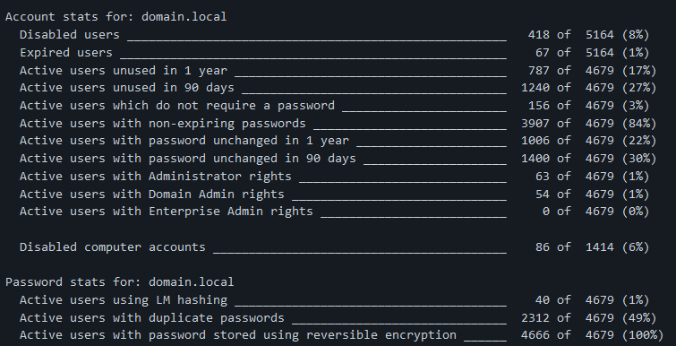
Defensive Uses of Password Cracking
Password strength auditing
Notes:
A company can dump their own password hashes and attempt to crack them in order to audit the strength of their user’s passwords.
https://github.com/Dionach/NtdsAudit

Slide 51

Wrap-up
Loyce, Shannon, Kim and Jonathan!
3:15-3:30

